Slide 1
Tables & Graphing
Laboratory Skills

Slide 2
Basic Tables
Tables, or charts, are used to organize information
Data in the form of numbers or words
Contains row and columns
Headers & Units
Table 1: Temperature with Increasing Time
Time (min) | Temperature (ºC)
0 | 24
1 | 38
2 | 52

Slide 3
Preparing Tables
Decided where data goes: into columns or rows
Chose the order: high to low or vice versa
Label the rows and columns with short, clear headers
Write a descriptive title starting with the y vs. x variable name, then expand into a complete statement (all caps)
If listing more than one Table in a report, number them
Include other important information:
Date information was collected
A brief explanation and key terms

Slide 4
Graphing
A graph is a visual display of data used to reveal a pattern in the data
Many types of graphs: circle, bar, line, etc.
Line graphs & Curves are often used
Independent(x-axis) and Dependent (y-axis) variables
Linear: y = mx + b
Curves: exponential; logarithmic; polynominal
Slopes: positive (direct) or negative (indirect)
Determine pattern by drawing a Best Fit Line (Curve)

Slide 5
Procedure: Drawing a Graph
Identify the independent and dependent variables
Choose a scale proportionally from the given range; use intervals when inserting numbers
Plot each point as a dark dot with a small circle around it – done for only experimental data
Label each axis with the variable name and unit
Title your graph. Should state purpose and include both variables in the order: y vs. x
Draw the line or curve of Best Fit

Slide 6
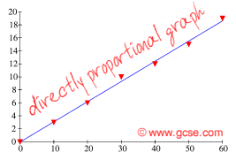
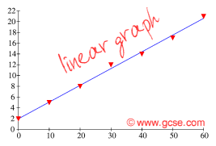
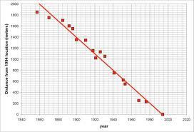
Interpreting Graphs
Proportionality
Directly proportional if an increase in one causes a increase in the other or vice versa (h h or i i)
Indirectly proportional if an increase in one causes a decrease in the other (h i)
y = mx
y = mx + c

Slide 7
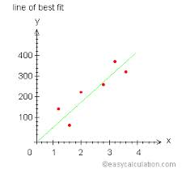
Interpreting Graphs
Line of Best Fit is a straight or cirved line which approximates the relationship among a set of data points. (This line usually does not pass through all measured points.)
Interpolation is the process of choosing a value from the best fit line, not a data point (unless it is on the line)
Extrapolation is the process of extending the line of best fit beyond the region in which the data was measured.

Slide 8
Things to Remember
No breaks in the graph! Must identify numerical value at the origin.
When calculating the slope, remember to include not only the number but also its units!
Fill page with plot – don’t make it too small.


